Slide 1

The 4 colour theorem
CC BY-SA 3.0
Image by Inductiveload - Based on a this raster image by chas zzz brown on en.wikipedia., CC BY-SA 3.0, https://commons.wikimedia.org/w/index.php?curid=1680050

Slide 2
The 4 colour theorem
GNU Russel Winder
“You only need 4 felt-tips to colour in a map”
Proposed 1852
Proved 1976, then correctly 1989
400 pages of proof
1,834 individual cases checked by computer

Slide 3
That’s too easy!

Slide 4
The 5 colour theorem
“You only need 5 felt-tips to colour in a map”

Slide 5
The 5 colour theorem
The proof fits on one page
Proof by induction, trust me
One case left to consider...

Slide 6
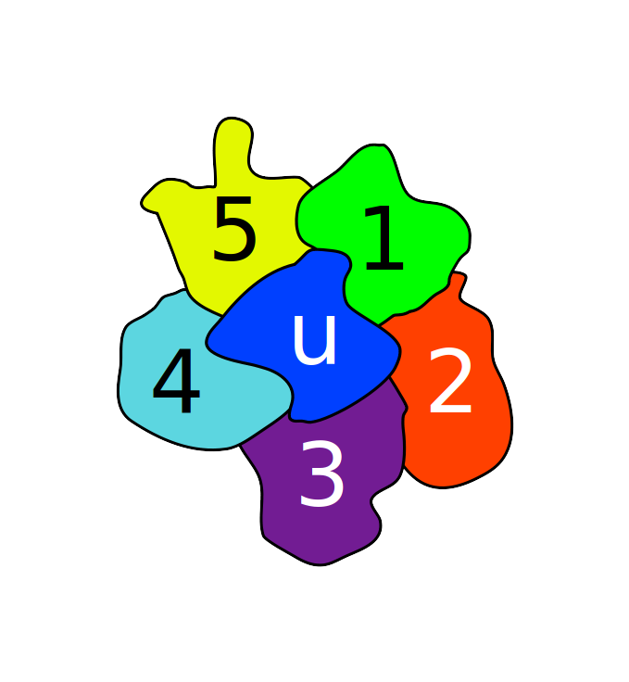
Imagine it’s impossible
Ideas from https://slaystudy.com/5-color-theorem/

Slide 7
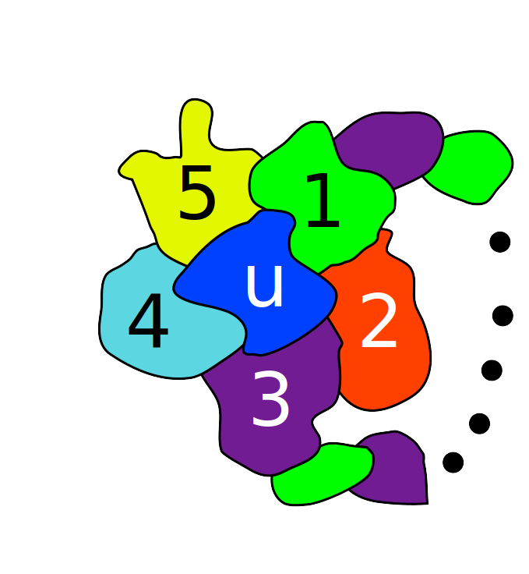
Why are 1 & 3 different colours?
Ideas from https://slaystudy.com/5-color-theorem/

Slide 8
But then why are 2 & 4 different colours?
Ideas from https://slaystudy.com/5-color-theorem/

Slide 9
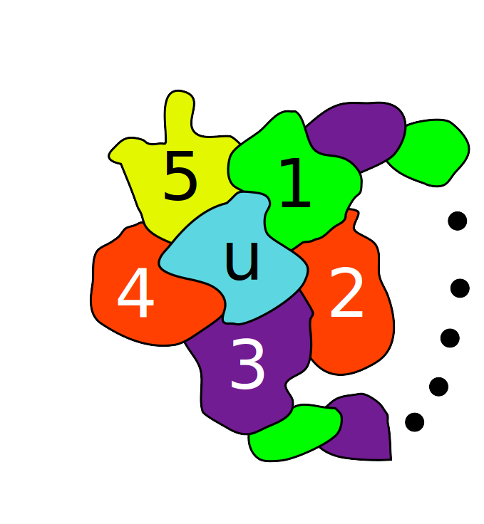
Fix it
Ideas from https://slaystudy.com/5-color-theorem/

Slide 10
Q.E.D.
(Details left as an exercise for the reader)

